Slide 1
Cutting SAW Vinyl with Cricut Maker
Last updated: 2021.05.04
May the 4th be with you!

Slide 2
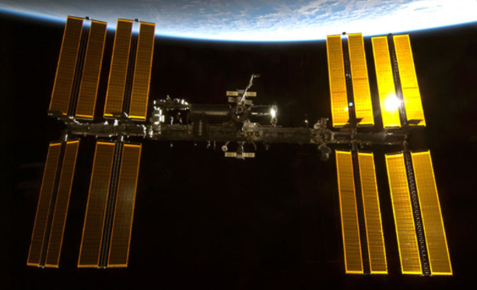
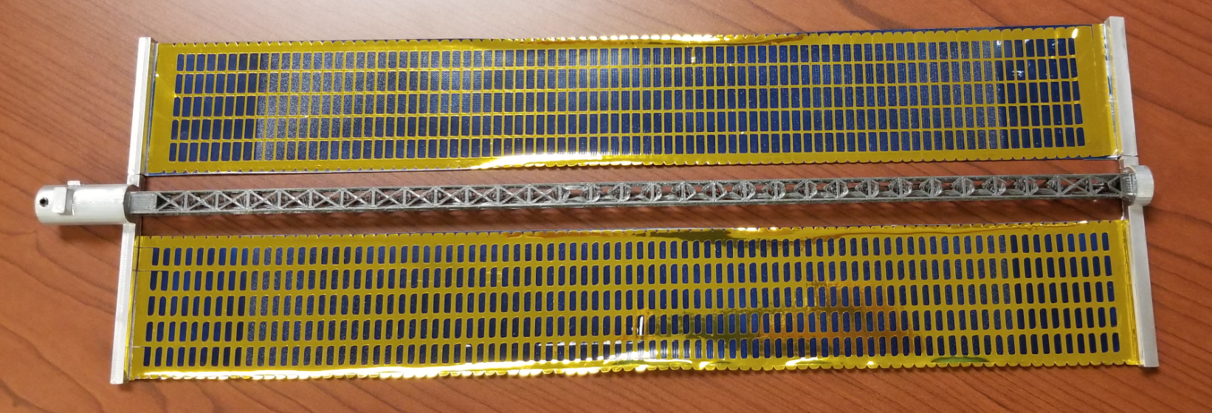
What you are making
Vinyl stickers for the ISS Solar Arrays using a Vinyl cutter (golden shinny stuff)
Quantity needed: 16 panels per ISS (Each cut yields 5 panels, so 4 cuts )
Size per panel: ~32cm x ~4.5cm
32 cm
4.5 cm

Slide 3
Here is what you need
Cricut Maker
Cricut Design Space v6.7.201 (used here for images)
SAW file (download from Github)
3D printed & painted ISS Solar Panel
12 x 24 Cricut mat
Shinny Vinyl
Embossing tool or Weeding tool
Tweezers (optional, but recommended)
Transfer tape
Scissors or Paper cutter
Patience + loads of time for weeding

Slide 4
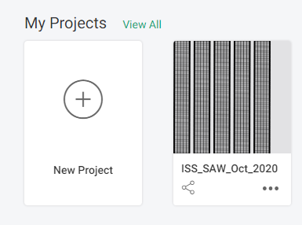
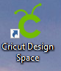
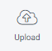
Turn on & plug in Cricut Maker
Launch Cricut Design Space
Click New Project
- Project image will be saved to My Projects for future use after initial upload (see example right)
Click Upload
Click Upload Image
Drag and drop ISS SAW file into window or click Browse to locate file to upload
Click Continue
Click the image/project you just uploaded
Click Insert Image
3

Slide 5
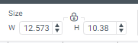
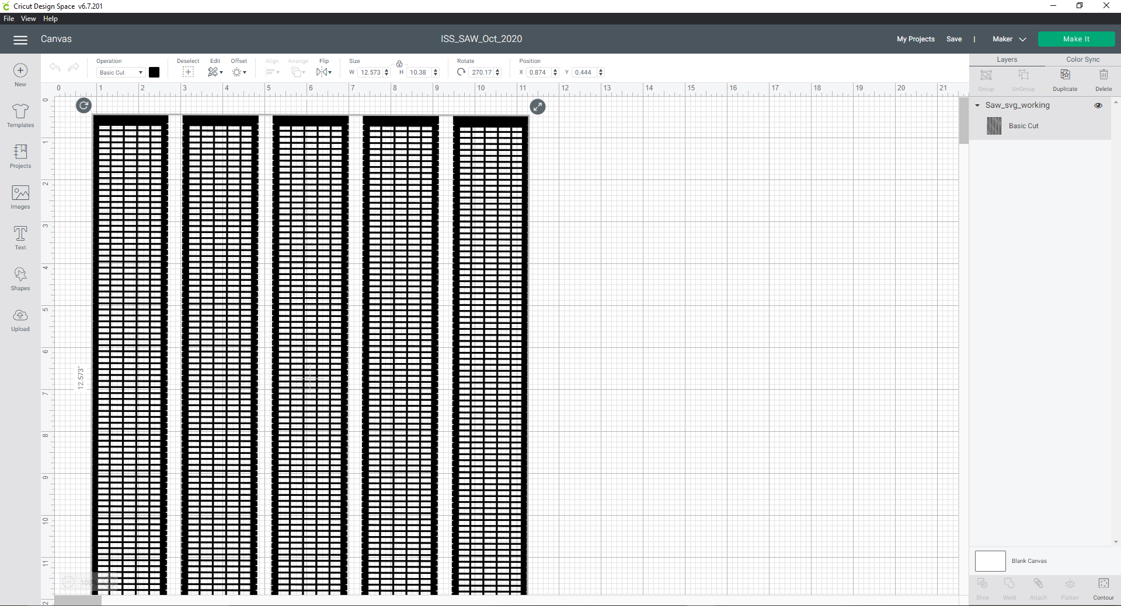
12
10
11
Adjust image by spinning the image length wise, move image to be within 12’’. Cricut mat is 12x24, thus the side of image greater than 12’’ need to be oriented properly
Image size should have auto adjusted to above, but if needed adjust as needed. W = 12.573 H will auto adjust
Click Make It
12.573’’
10.38’’

Slide 6
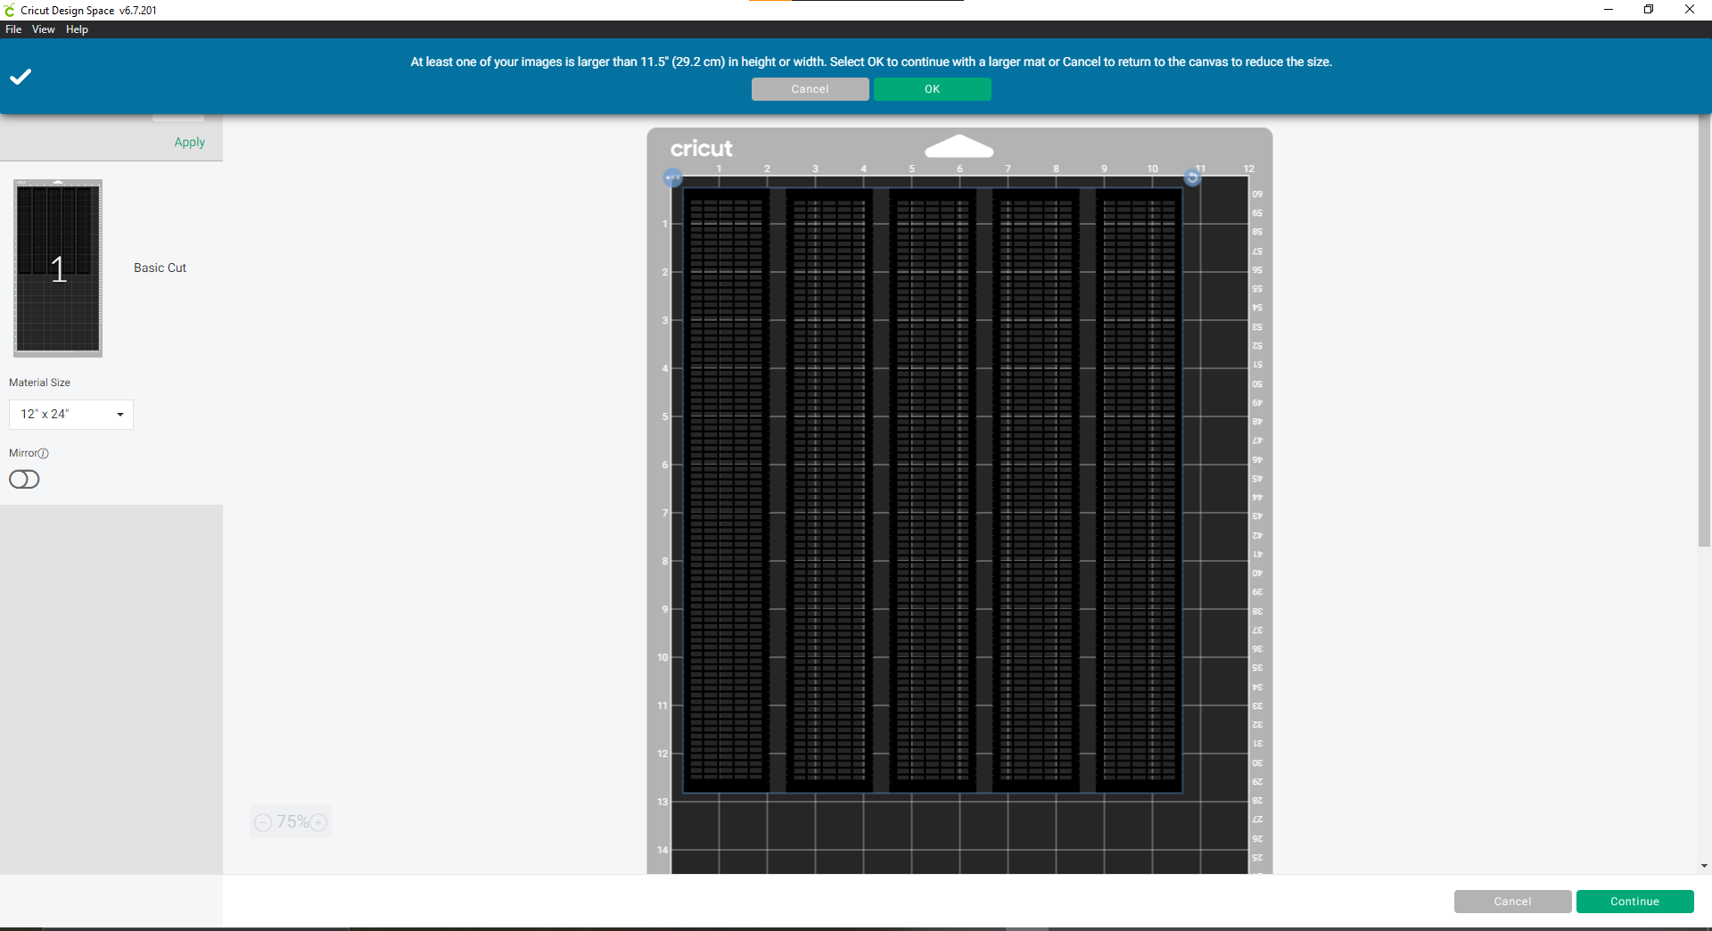

14
15
13
16
13
If needed, adjust placement of image to be within mat size (12’’ x 24’’). Placement of image on this virtual mat will mirror placement of image to be cut on the physical mat when feed into Circuit cutter later, so plan ahead
Click Ok to acknowledge using a larger mat
Double check Material Size box says 12” x 24”, if not find and select using drop down arrow. This is the size of mat to be used.
Click Continue

Slide 7
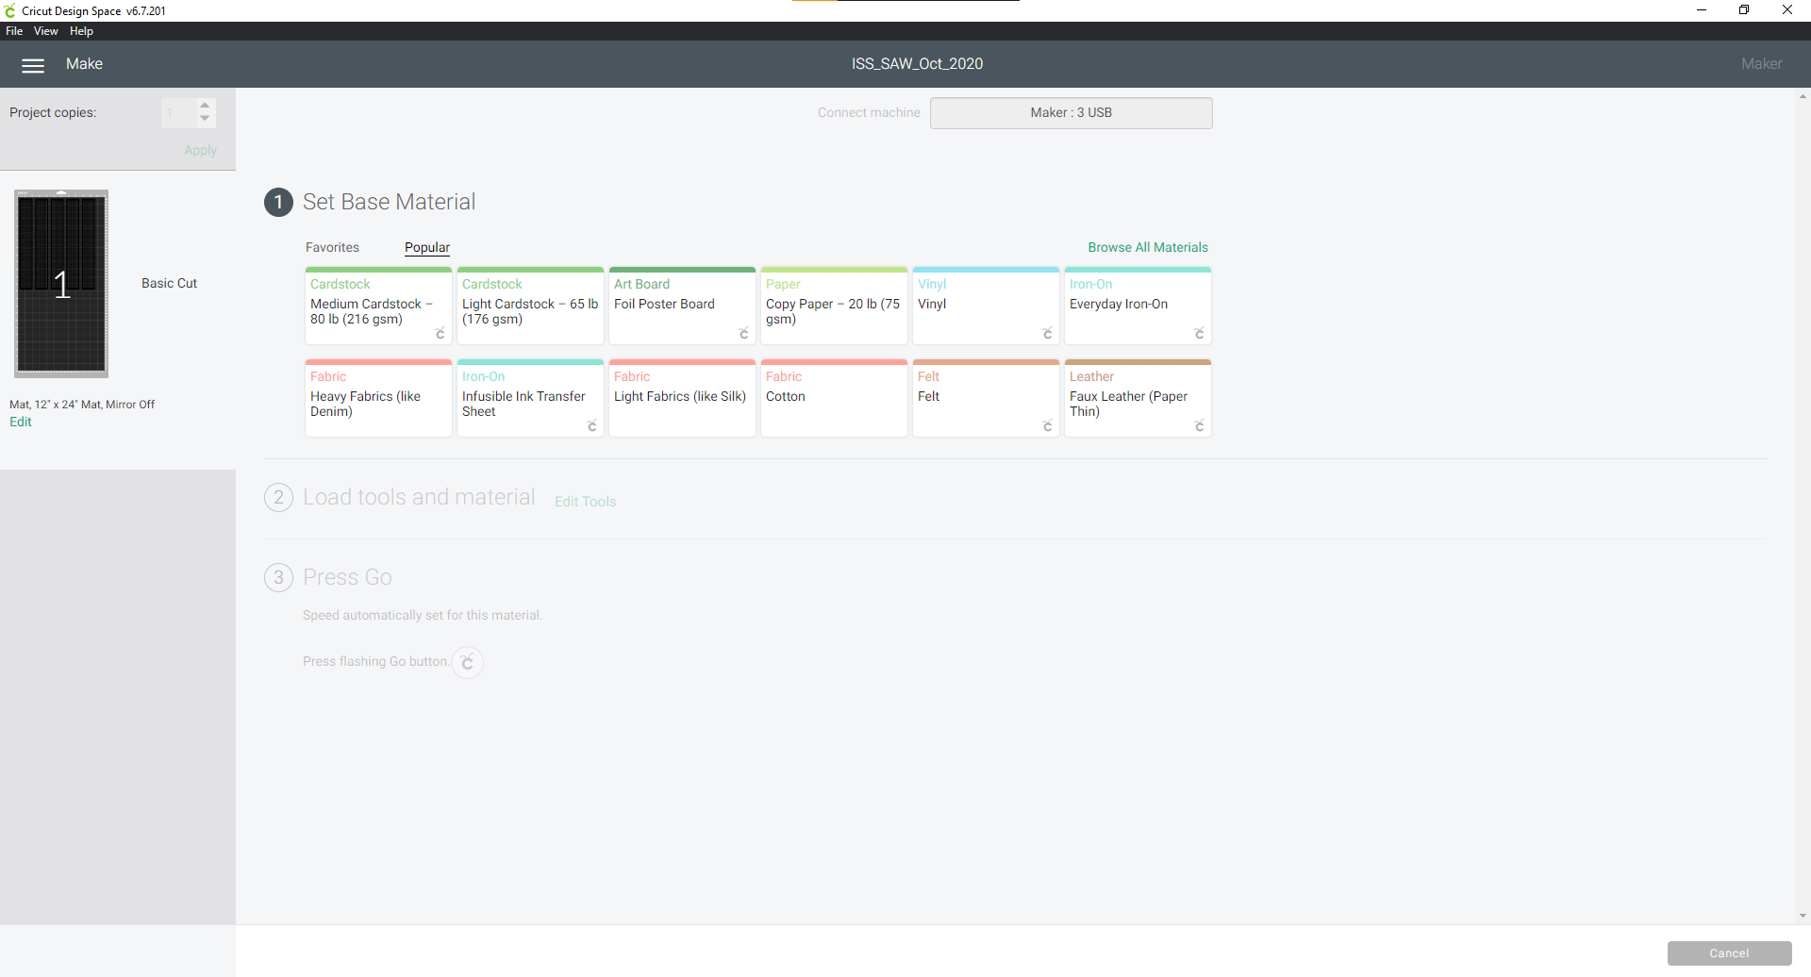
16
Click to select Vinyl

Slide 8
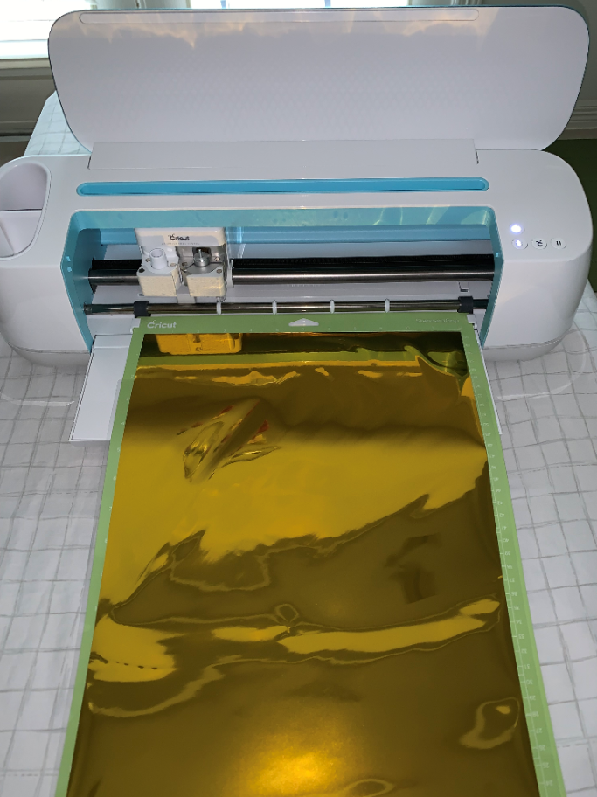
Cricut unit placement : Allow at least 24” of space between back of unit to any object, such as a wall. This will accommodate the physical mat travel space as it cuts
Prep Vinyl and mat:
Remove protective film from 12x24” mat (save for later use). Place mat on a flat surface, sticky side up
Unroll Vinyl, place and align Vinyl sheet onto sticky mat, this can be tricky. Easier with a second set of hands, go find a volunteer! Be sure Vinyl cover the surface area on mat shown on preview in step 13.
If needed to adjust Vinyl placement on mat, Flip mat onto a flat surface, Vinyl side down. Carpet floor works just fine. Secure Vinyl with one hand flat against surface, peel mat slowly from Vinyl (instead of Vinyl from mat, this will result in less curl up Vinyl).
When ready, peel off clear protective film off Vinyl (trash later), then load mat onto Cricut unit track

Slide 9
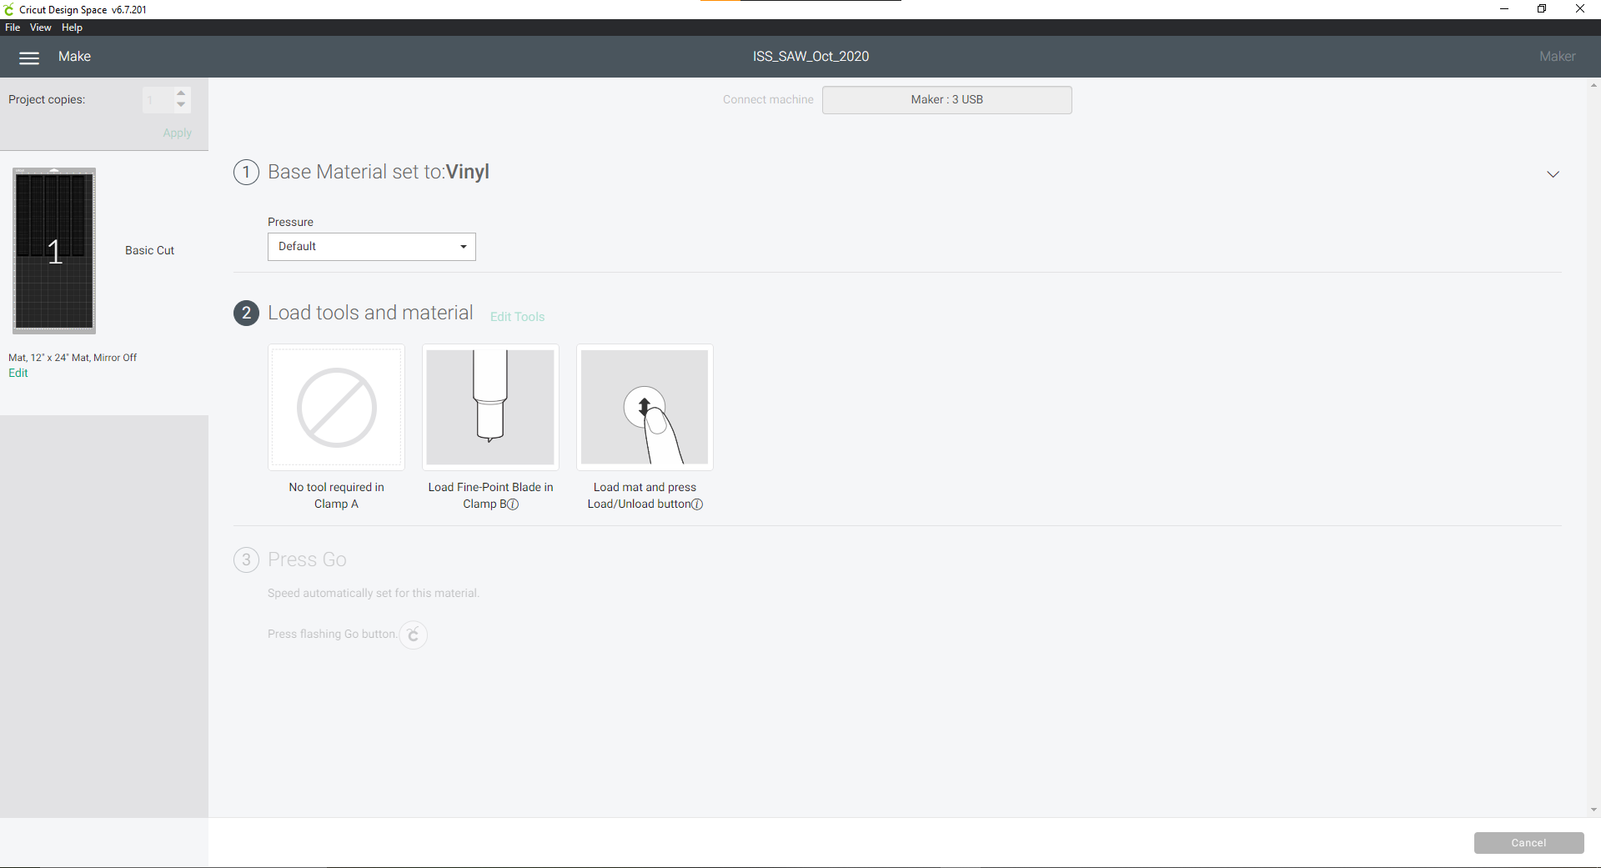
Check to make sure Fine-Point Blade is in Clamp B. (Pre-install in unit out of box)
Press Load button on the Cricut unit. Button should be flashing

Slide 10
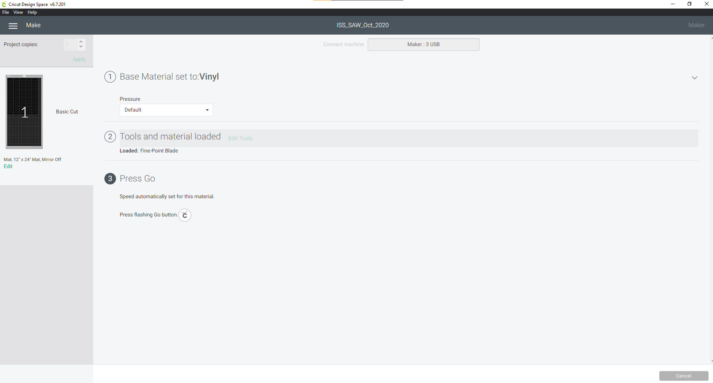
Press Go Cricut button on the Cricut unit. Button should be flashing

Slide 11
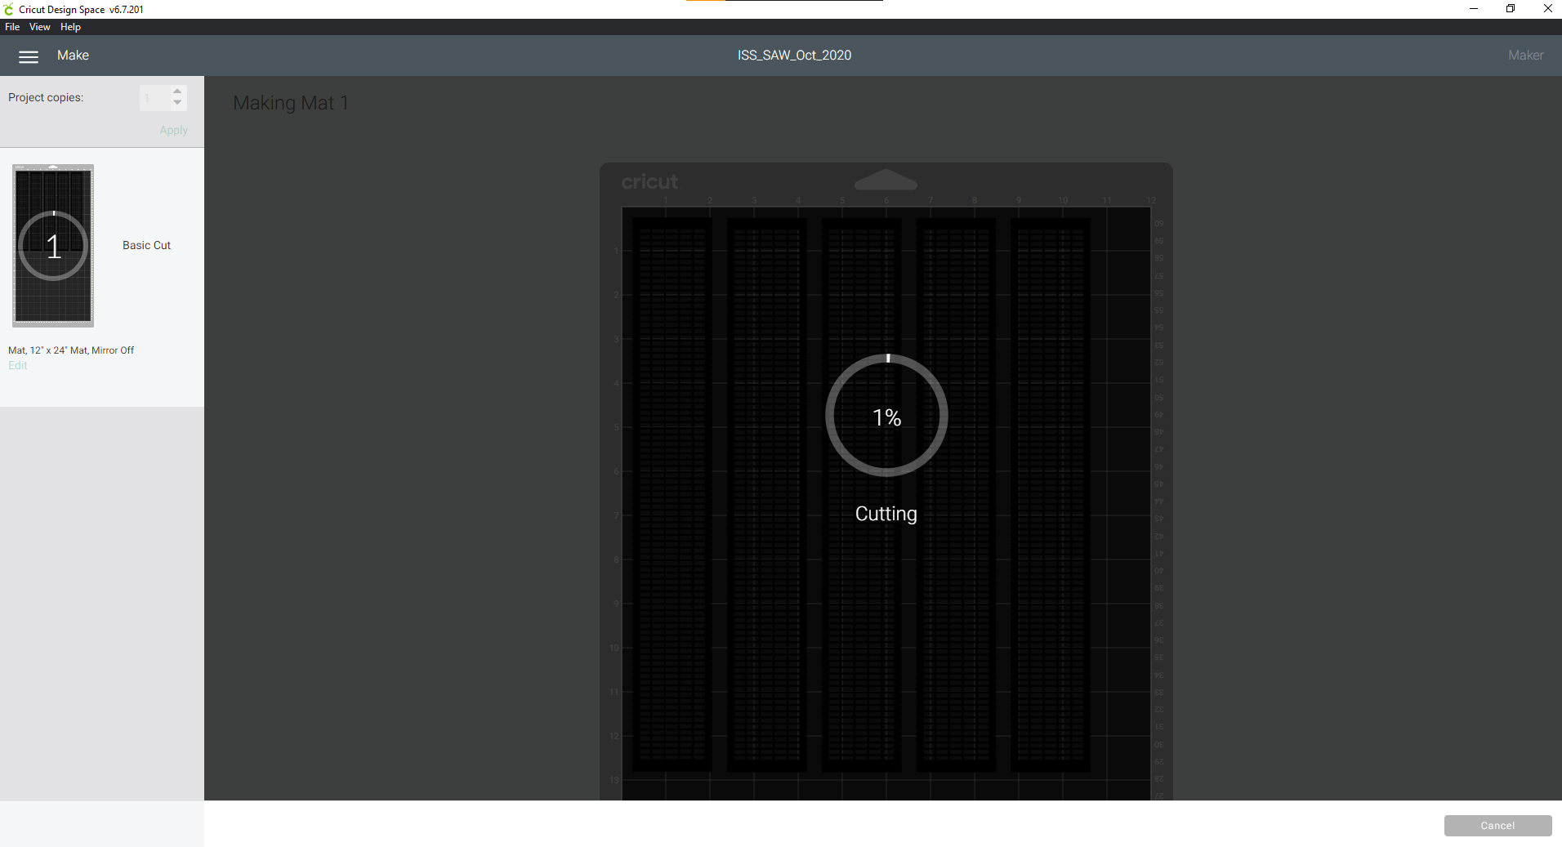
Sit back and enjoy the cutting show.

Slide 12
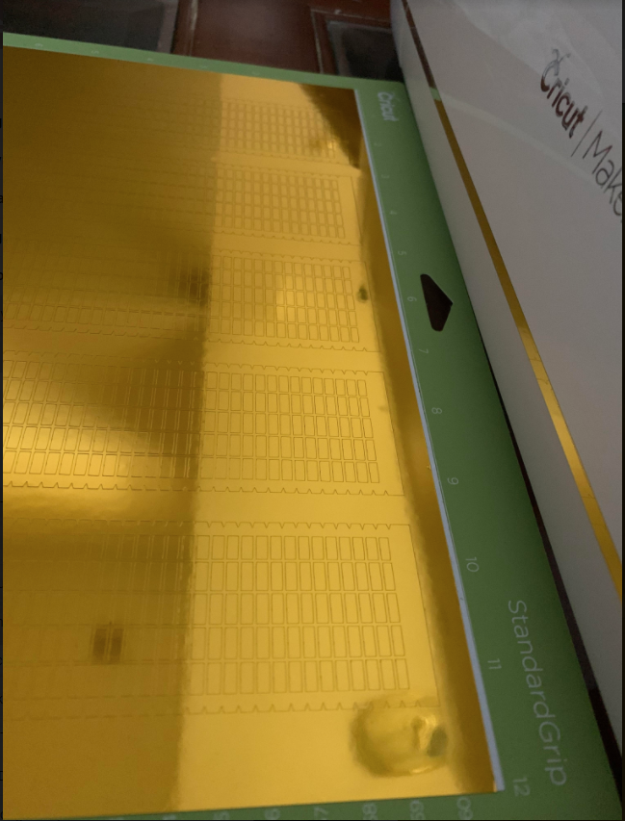
Final product looks something like this after cut is complete
Release Vinyl from mat:
Remove mat from Cricut unit
Flip mat onto a flat surface, Vinyl side down. Carpet floor works just fine. Secure Vinyl with one hand flat against surface, peel mat slowly from Vinyl (instead of Vinyl from mat, this will result in less curl up Vinyl).
Place protective film back onto mat sticky side
Using scissors or paper cutter to cut SAW section from Vinyl roll
Repeat all steps on additional cuts using Cricut
Weeding the Vinyl of SAW image
Place the cut SAW Vinyl on a flat solid surface, such as a clip board, counter top or desk. I used clip board to be easier on neck and back
Use an embossing tool or weeding tool to pick and remove each small tiny rectangles. The tiny rectangles are to be trashed, but the delicate outlines are kept, so be careful not to damage them.
Using embossing tool, firmly press from corner of tiny rectangle, push up to release it (adhesive back) from backing sheet. Use tweezers or fingers to remove tiny rectangles, and trash. Yes! There are a lot of them, all rectangles will need to be removed

Slide 13
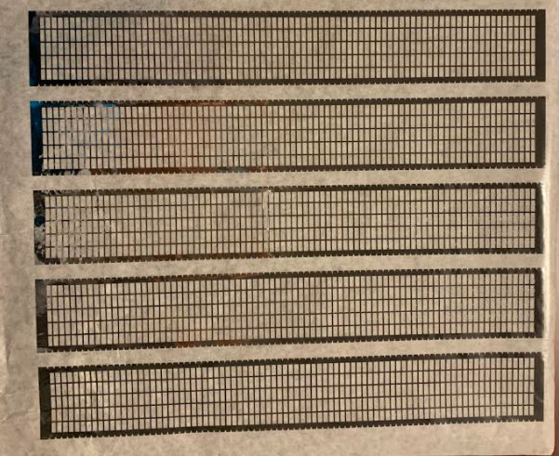
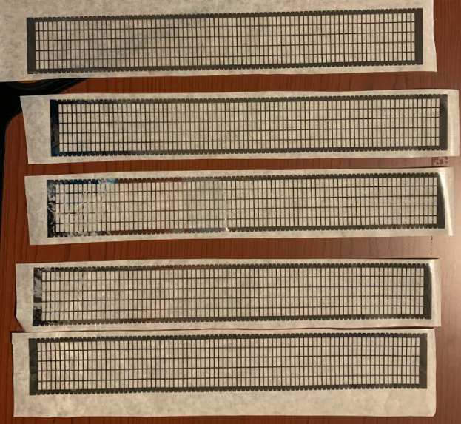
After tiny rectangles are removed + onto transfer paper
Cut
Transfer tape
Cut transfer tape from roll, need to be slightly larger than the Vinyl cut. Extra room with transfer tape will allow easier placement/handling onto 3D print later
Place transfer tape onto Vinyl, sticky side of transfer tape to shinny side of Vinyl. Press down for good contact.
Holding transfer tape, peel SAW outlie from Vinyl backing. At the end, both transfer tape sticky side and Vinyl sticky side are on the same side
Cut transfer tape between the images to free each SAW outline from the group

Slide 14
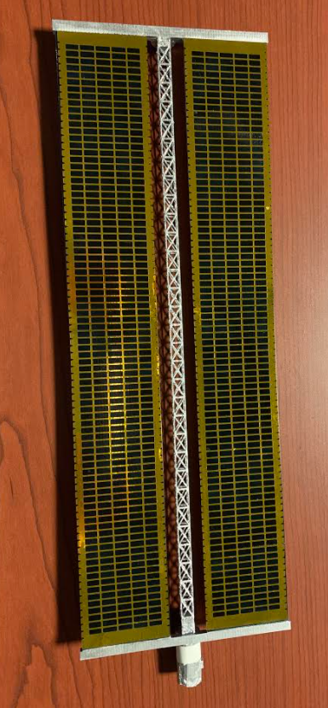
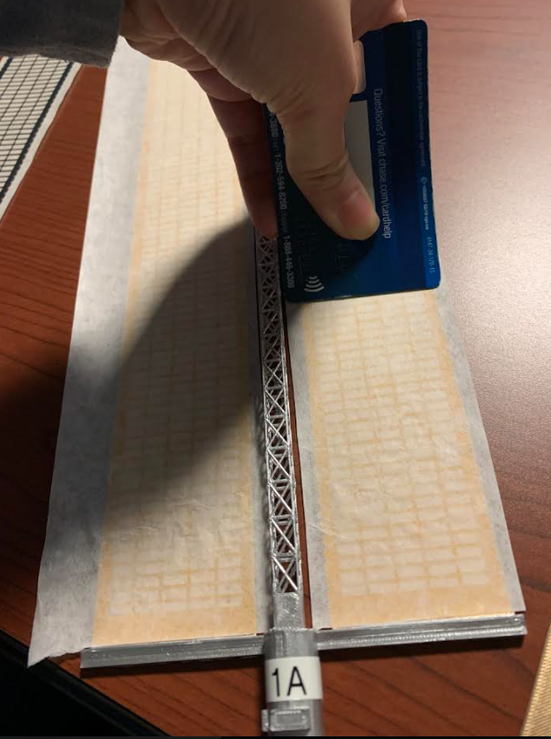
Transfer Vinyl onto 3D print. With Vinyl + transfer tape sticky side down, align Vinyl and place onto 3D printed solar panel. (Gold edges should cover all the blue paint area, just touching the silver area) Once all is aligned, use a credit card to press and slide on the transfer tape to secure adhesive onto 3D print
Remove transfer tape. Start from a corner, pull slowly at a 45 degree angle to peel transfer tape away from Vinyl
Once complete, Vinyl will stay on the 3D print, transfer paper gone (trash). ISS panel would look like above

